Slide 1

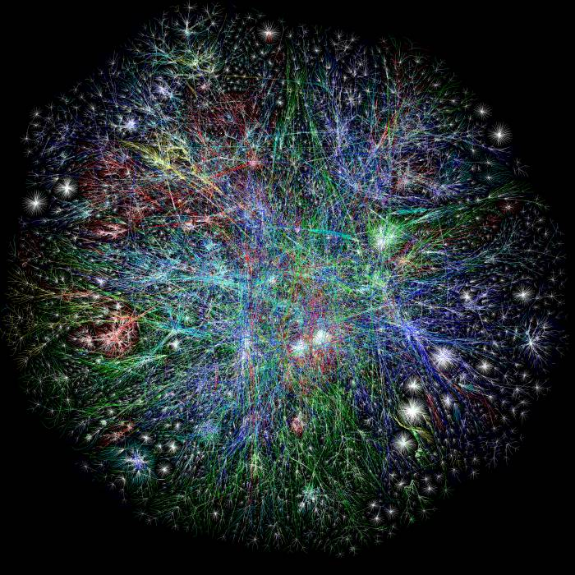
National Aeronautics and Space Administration
The Model Web
Consultative infrastructures
for decision makers and researchers
Biodiversity and Ecological Forecasting Team Meeting
Rosslyn, VA
22-24 April 2013
Gary Geller
Jet Propulsion Laboratory
California Institute of Technology
(c) 2013 California Institute of Technology. Government sponsorship acknowledged.
Notes:
1
Model web is a concept that’s been around for about 5 years or so, and pieces of implementation are starting to appear. Here, review the concept and then talk about some of these pieces.

Slide 2
NASA Ecology Meeting, May 2008
Need “integrated research”
Need “major investment in impact models”
Need “a new generation of integrated modeling”
Need “model comparisons…coordinated agenda”
Need “to investigate alternative futures”
Need “a new NASA program”
Notes:
Third: (Tony Janetos)
Last: (Chris Field)
My interpretation: we need improved modeling capabilities, with greater coordination and integration…and maybe a new NASA program

Slide 3
Model Web Long-Term Vision
A dynamic web of models, integrated with databases and websites, to form a consultative infrastructure providing insight into “what if” questions
Notes:
This is basically a WWW for models…or the model portion of the Semantic Web

Slide 4
Model Web Long-Term Vision
A dynamic web of models, integrated with databases and websites, to form a consultative infrastructure providing insight into “what if” questions
Notes:
This is basically a WWW for models…or the model portion of the Semantic Web

Slide 5
Model Web Long-Term Vision
A dynamic web of models, integrated with databases and websites, to form a consultative infrastructure providing insight into “what if” questions
Notes:
This is basically a WWW for models…or the model portion of the Semantic Web

Slide 6
Model Web Long-Term Vision
A dynamic web of models, integrated with databases and websites, to form a consultative infrastructure providing insight into “what if” questions
Notes:
This is basically a WWW for models…or the model portion of the Semantic Web

Slide 7
Model Web Long-Term Vision
A dynamic web of models, integrated with databases and websites, to form a consultative infrastructure providing insight into “what if” questions
Open access to models
Use web services
Model-model interoperability
Minimal entry barriers
Notes:
This is basically a WWW for models…or the model portion of the Semantic Web

Slide 8
What Would a Model Web Look Like?
Climate
Socioeconomic
Fire
Risk
Frequency
Intensity
Behavior
Emissions
Landscape
Ecotype
Tree density
Biomass
Disturbance
Succession
Composition
Biogeochemical
Local / landscape
water & energy
balance
Carbon
Accounting
Sequestration
Allocation
Flows
Public Health
Vector distribution and abundance
Deforestation
Population density
Behavior
Education
Countermeasures
Etc
Species
distribution
Invasive species
Ecosystem
Services
Public health

Slide 9
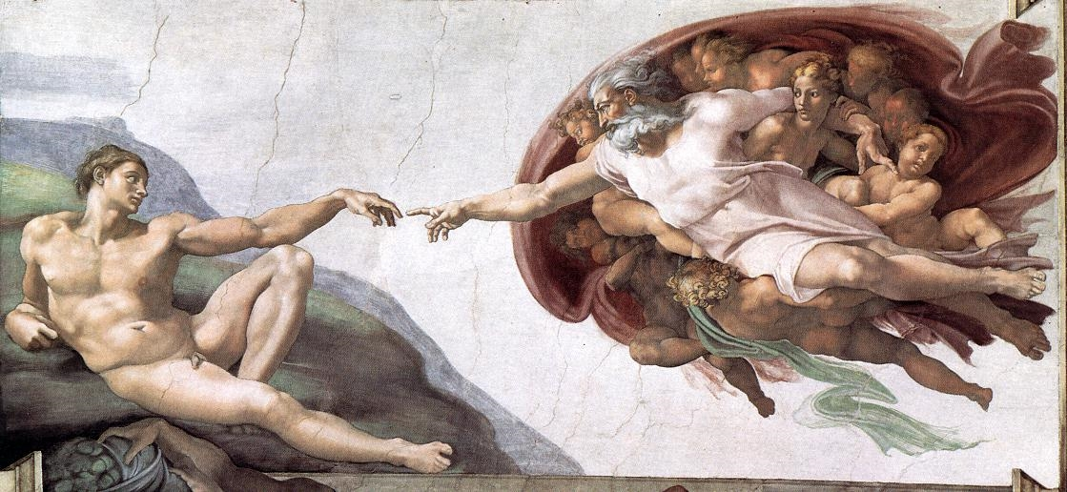
Websites
Connect people to information
Notes:
Portals are the conduits out of the model web
Anyone can set one up
Understand topic
Decide what questions to address
Decide what models to use
Validate outputs
Image from wikimedia commons

Slide 10
What Would a Model Web Look Like?
Climate
Socioeconomic
Fire
Risk
Frequency
Intensity
Behavior
Emissions
Landscape
Ecotype
Tree density
Biomass
Disturbance
Succession
Composition
Biogeochemical
Local / landscape
water & energy
balance
Carbon
Accounting
Sequestration
Allocation
Flows
Public Health
Vector distribution and abundance
Deforestation
Population density
Behavior
Education
Countermeasures
Etc
Species
distribution
Invasive species
Ecosystem
Services
Public health

Slide 11
Does a Model Web exist?

Slide 12
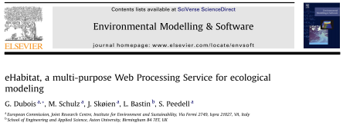
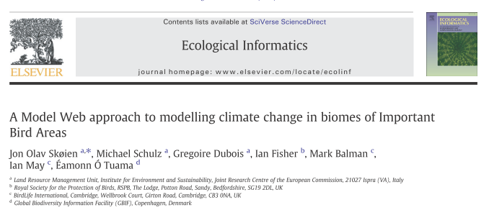
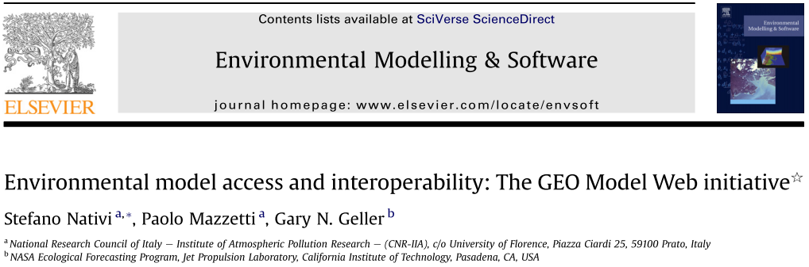
Model Web Pieces
GEO Model Web activity
  Includes model interoperability enhancement via “brokers”
eHabitat
EuroGEOSS
Uncertweb

Slide 13
eHabitat
Developed by EC Joint Research Centre
  Give it a particular area or habitat
  Finds other locations with similar characteristics
Accessible as a web service
Used in various contexts
Notes:
Uses Mahalanobis distance

Slide 14
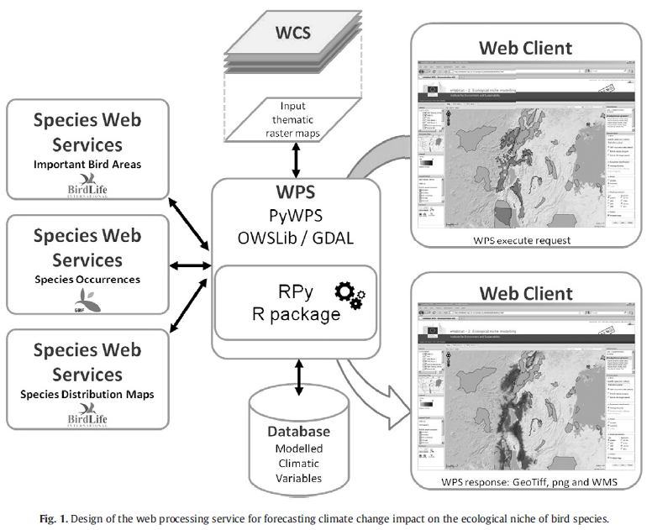
eHabitat Service
…
Protected Areas
Any area
Any spatial dataset
Skøien, J.O., et al. 2013. A Model Web approach to modelling climate change in biomes of Important Bird Areas, Ecological Informatics 14: 38-43
Notes:
Here, eHabitat is used in conjunction with spatial data of various types

Slide 15
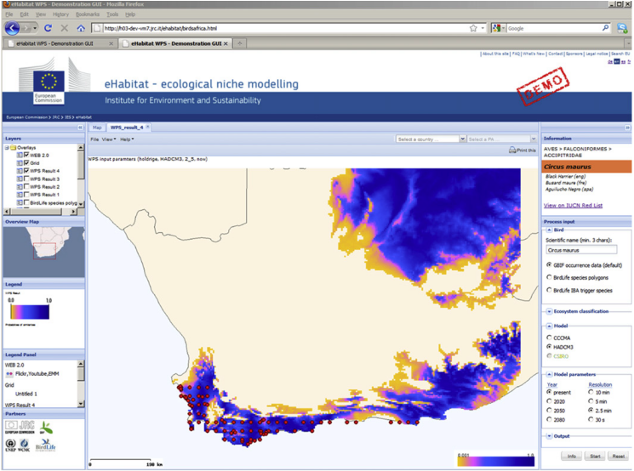
eHabitat Web I/F for SDM
Red dots: GBIF occurrence data
for Black Harrier
Color areas: similar
habitat (present)
Dubois, G., et al. 2013. eHabitat, a multi-purpose Web Processing Service for ecological modeling. Envir Modeling & Software 41: 123-133

Slide 16
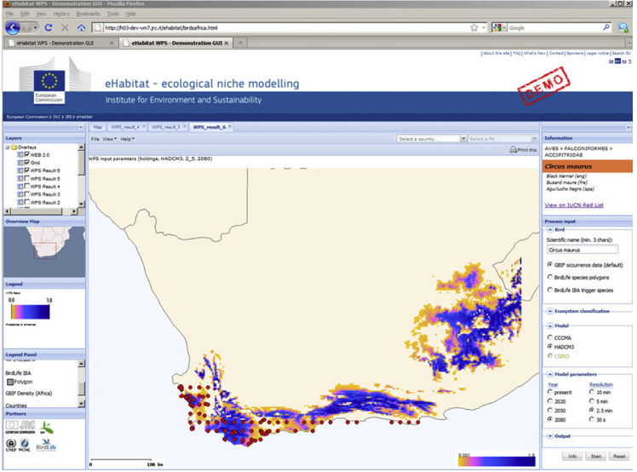
Similar Habitat in 2080

Slide 17
eHabitat and Model Web
Focus here: concept
Need more?
  Add another model
Don’t like web client?
  Build your own
Don’t like the details?
  Swap out models
  Use different input datasets
Notes:
Missing: more models! In fact are using eHabitat in a broader modeling context as part of the Digital Observatory of PAs, and other work.

Slide 18
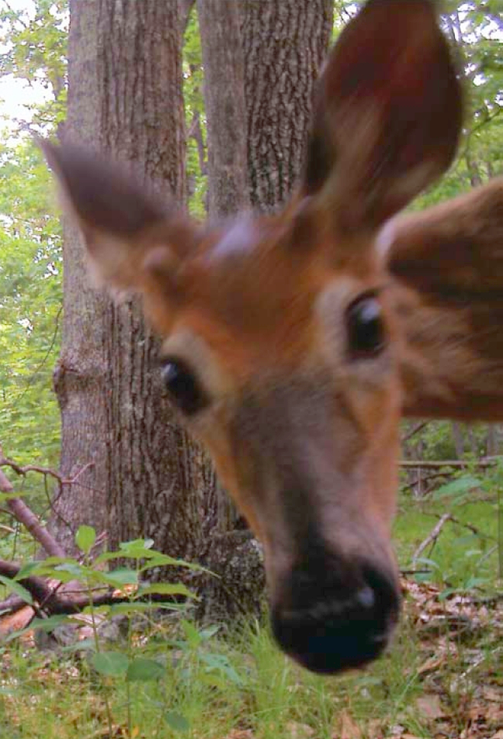
Wrap Up
Facilitates access, reuse
Increases the ROI of models
Expectation: will grow, slowly
  Providing “Easy access” isn’t easy
Long-term vision
  Accessible, interacting models forming a consultative infrastructure

